Slide 1
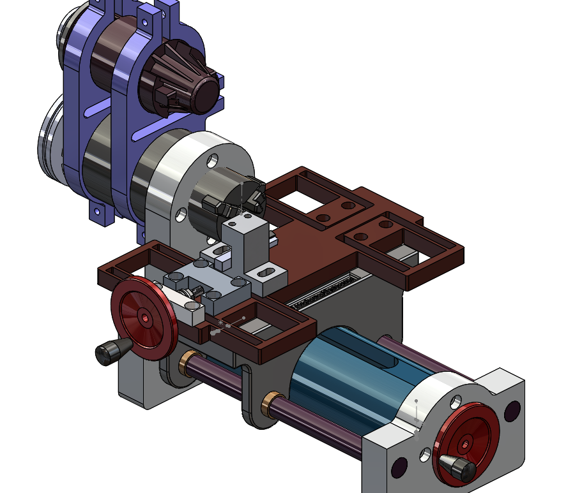
1 – Part
2 – Chuck
3 – Spindle Shaft
4 – Bearings
5 – Headstock
6 – Rail
7 – Carriage
8 – Flexure
9 – Tool post
10 – Tool
3
4
2
1
10
9
5
8
7
6

